Slide 1
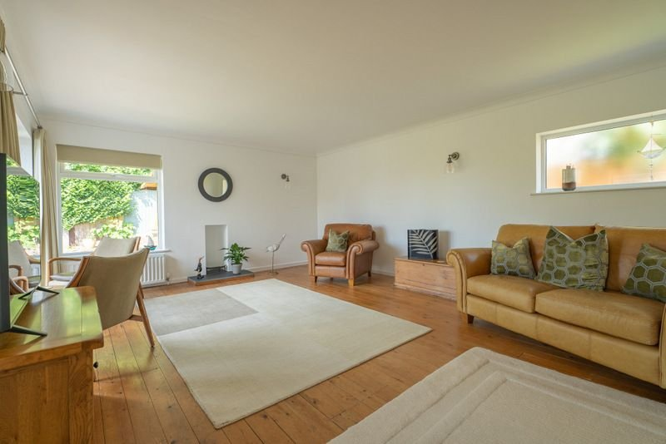
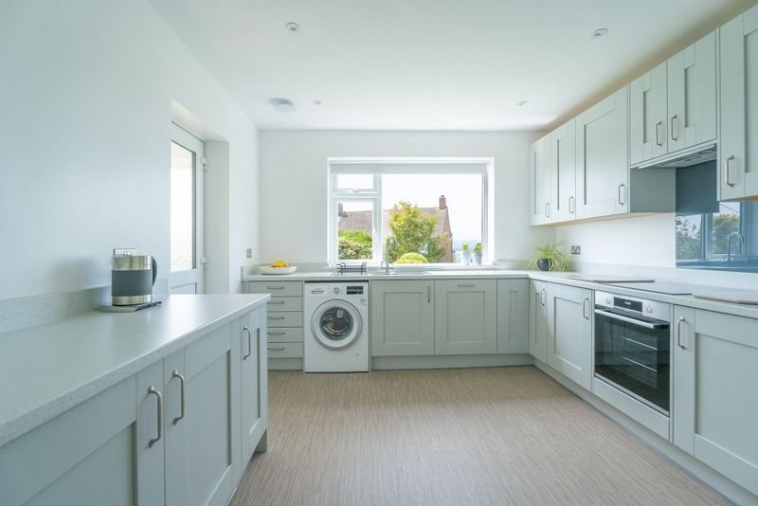
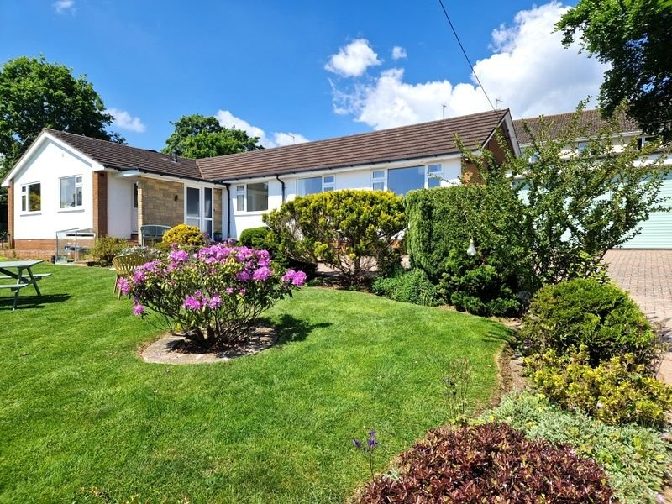
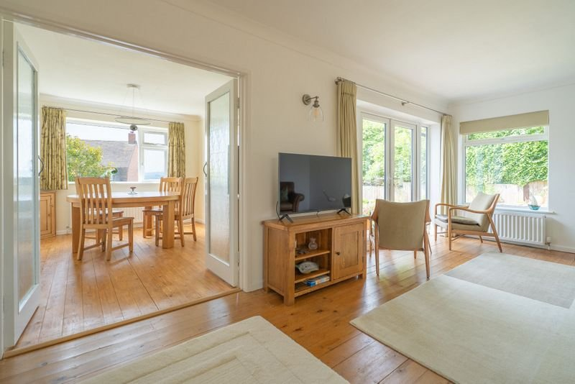
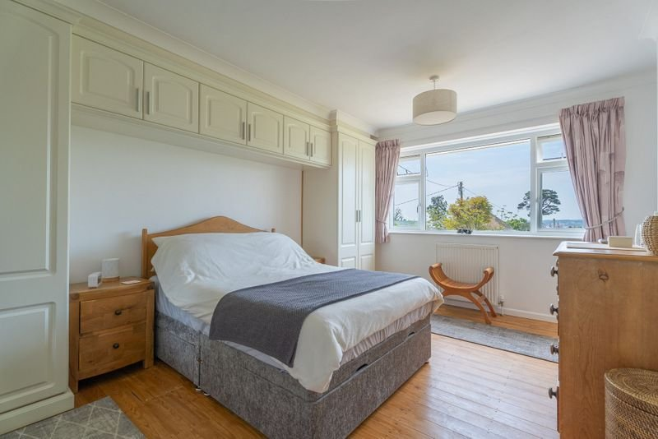
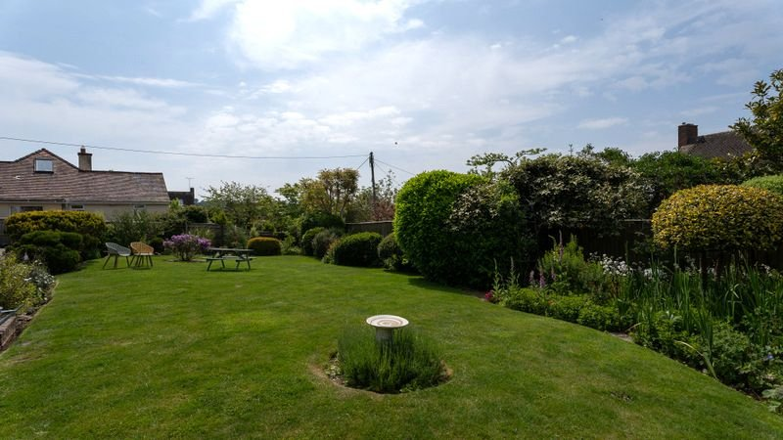
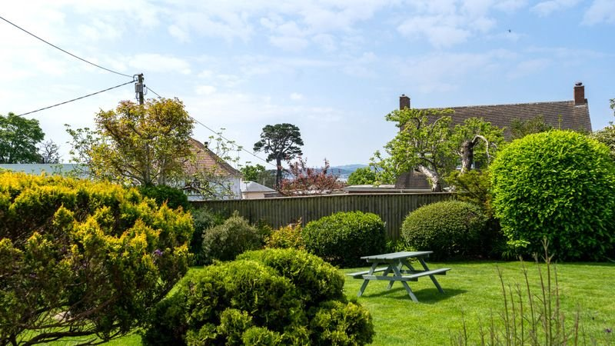
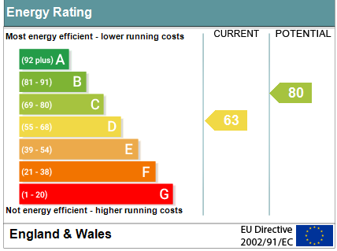
www.pennys.net
Springfield, Orchard Close, Lympstone, EX8 5LA
GUIDE PRICE £875,000
TENURE Freehold
A Truly Stunning Detached Residence Located In A Highly Desirable Private Road In The Sought After Village Of Lympstone
Entrance Porch, Spacious Reception Hall & Inner Hallway •
Newly Fitted Modern Kitchen With Integrated Appliances • Bright & Spacious Lounge Affording Stunning Estuary Views With Patio Doors Opening Onto Patio Area • Dual Aspect Dining Room • Three Bedrooms - Main Bedroom Fitted With A Range Of Built-In Wardrobes & Ensuite/WC •
Main Shower Room/WC & Separate Cloakroom/WC • Beautifully Landscaped Gardens Offering An Abundance Of Colour With Well Stocked Flower & Shrub Beds • Double Garage With Electric Roller Door • Affording Open Views Towards The Estuary & Beyond •
Viewing Highly Recommended •
Pennys Estate Agents Limited for themselves and for the vendor of this property whose agents they are give notice that:- (1) These particulars do not constitute any part of an offer or a contract. (2) All statements contained in these particulars are made without responsibility on the part of Pennys Estate Agents Limited. (3) None of the statements contained in these particulars are to be relied upon as a statement or representation of fact. (4) Any intending purchaser must satisfy himself/herself by inspection or otherwise as to the correctness of each of the statements contained in these particulars. (5) The vendor does not make or give and neither do Pennys Estate Agents Limited nor any person in their employment has any authority to make or give any representation or warranty whatever in relation to this property.
PENNYS ESTATE AGENTS
2 Rolle House, Rolle Street, Exmouth, Devon, EX8 2SN
Tel: 01395 264111 EMail: help@pennys.net

Slide 2
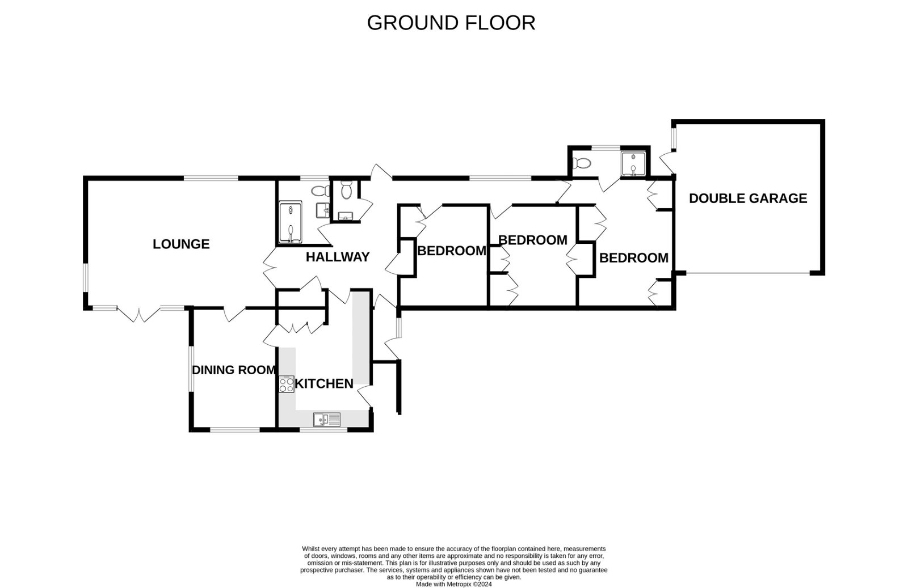
Springfield, Orchard Close, Lympstone, EX8 5LA
A Truly Stunning Detached Residence Located In A Highly Desirable Private Road In The Sought After Village Of Lympstone
Pennys are delighted to offer for sale Springfield, this spacious detached bungalow enjoying an enviable location along a private road. The accommodation has been beautifully refurbished by the present owners and now boasts a modern kitchen and shower room along with enjoying bright and spacious living accommodation. Standing in attractive grounds of approximately 0.22 of an acre with ample off-road parking offered via a sweeping block paved driveway, turning area and double garage. A viewing of this high quality home is strongly recommended. LOCATION: Lympstone is a highly regarded village in the favoured Exe Estuary with an excellent range of local facilities including a sailing club, pubs, village hall, general store with post office, primary and pre-schools as well as an independent preparatory school. There is a railway station connecting to Exeter. Nearby is the Exe Estuary Trail, a cycle path and walkway which runs around Exe Estuary linking Exmouth, Exeter and Dawlish. The centre of Exeter is 8.5 miles whilst junction 30 of the M5 motorway is 8 miles. THE ACCOMMODATION COMPRISES: uPVC double glazed front door with obscure glass and matching picture window side screen to: ENTRANCE PORCH: 1.83m x 1.19m (6'0" x 3'11") Tiled floor; coat rack; wall light; inner glazed panel door to: RECEPTION HALL: A stunning entrance to the property with oak flooring; radiator; dado rail; coved ceiling; access to roof space via loft ladder; linen cupboard housing newly fitted Worcester boiler and slatted shelving; further cupboard with coat rack and shelving with cupboard above; with opening through to INNER HALLWAY. LOUNGE: 6.68m x 4.52m (21'11" x 14'10") A bright and spacious room with uPVC double glazed double doors opening onto PATIO AREA gaining stunning views towards the estuary, hills and beyond; further uPVC double glazed window to side aspect and uPVC double glazed picture window to rear aspect with obscure glass; stripped wood flooring; two radiators; television point; telephone point; stylish modern wall lighting; coved ceiling; double doors to: DINING ROOM: 4.27m x 3m (14'0" x 9'10") Stripped wood flooring; two uPVC double glazed windows to the front and side aspects overlooking the gardens and affording stunning views towards the estuary and beyond; radiator; television point; coved ceiling. KITCHEN: 4.75m x 3.3m (15'7" x 10'10") Maximum overall measurement. (Accessed from both Reception Hall & Dining Room) Newly fitted with pattern worktop surfaces with matching splashbacks; wide range of cupboards, drawer units, integrated dishwasher and plumbing for an automatic washing machine beneath worktop surface; inset one and a half bowl single drainer sink unit with chrome mixer tap; built-in induction hob with glass splashback, built-in electric oven below and concealed extractor hood above; matching range of wall mounted cupboards; floor to ceiling storage cupboards with power sockets; space for upright fridge freezer; uPVC double glazed window to front aspect overlooking the gardens and affording stunning views towards the estuary and beyond; radiator; recess ceiling LED spotlighting; feature wall light; ceiling extractor fan; uPVC double glazed door giving access to COVERED ENTRANCE PORCH which opens through to the gardens with courtesy light and tiled flooring.
MAIN SHOWER ROOM/WC: Stylishly fitted with a quality suite comprising ease of access double width shower cubicle with shower splash screens; vanity wash hand basin with cupboard beneath; WC with push button flush; chrome heated towel rail; attractive tiled walls with large wall mirror; tiled floor; extractor fan; uPVC double glazed window with obscure glass.
SEPARATE CLOAKROOM/WC: Fitted with space saver wash hand basin with vanity cupboard below; WC with push button flush; part tiled walls with attractive tiling; tiled floor; uPVC double glazed window with obscure glass; radiator.
INNER HALLWAY: uPVC double glazed door to REAR PAVED AREA with pattern glass; further uPVC double glazed picture window with obscure glass; radiator; doors to: BEDROOM ONE: 4.57m x 3.33m (15'0" x 10'11") Plus doorway recess. A spacious main bedroom fitted with a range of built-in wardrobes with wall mounted cupboards over bed area; additional built-in wardrobe; stripped wood flooring; radiator; coved ceiling; uPVC double glazed window to front aspect affording stunning views towards the estuary and beyond; door to:
EN-SUITE/WC: Comprising of a shower cubicle housing Mira shower unit; WC; radiator; tiled floor; attractive tiled walls; uPVC double glazed window to rear aspect with obscure glass. BEDROOM TWO: 3.05m x 3.53m (10'0" x 11'7") Range of built in wardrobes; radiator; uPVC double glazed window to front aspect gaining views towards the estuary and beyond. BEDROOM THREE: 3.63m x 3.12m (11'11" x 10'3") Maximum measurement into wall recess. Built-in wardrobe; radiator; uPVC double glazed window to front aspect enjoying pleasant views towards the estuary and beyond. OUTSIDE: The property enjoys an enviable location and is situated on a private road. Springfield is approached via a sweeping block paved driveway and turning area providing ample parking and leading to an attached DOUBLE GARAGE. The gardens are found mainly to the front of the property and are a wonderful feature to the property enjoying extensive lawned gardens, edged with well stocked flower and shrub beds providing an abundance of colour, block paved patio area, beautiful feature pond, block paved pathway and gate leading to an additional area of garden again laid to lawn and edged with colourful shrub beds with raised block paved patio positioned to take full advantage of the stunning views towards the estuary and beyond. There is a TIMBER SUMMER HOUSE 2.97m x 2.06m (9'9" x 6'9") with power and light connected. Directly to the rear of the bungalow there is a patio area with raised flower beds and pergola with patio pathway and gate giving access back to the front of the property. DOUBLE GARAGE: 5.26m x 5.21m (17'3" x 17'1") With electric roller door; power and light connected; electric consumer unit; gas and electric meters; door and uPVC double glazed window to rear patio area.
AGENTS NOTE: We have been advised the property has some covenants in place - Please ask a member of staff for further details.
FLOOR PLAN:

